Slide 1
APB to I2C Bridge Project
Team Name :
Amit Mohanty
G. Akshay Kumar
Kirti Kumar
Pratik Kumar Panda

Slide 2
Contents
Work assigned
TB Architecture
Architecture progress
Testcases planned
Coverage plan
Work remaining

Slide 3
Work assigned
Task | ETA | Status
Spec. study | 6th October | 100% Completed
Verification Plan | 12th October | 100 % Completed
TB structure and testcases | 3rd November | 70% Completed
Debugging and closure | 10th November | Upcoming

Slide 4
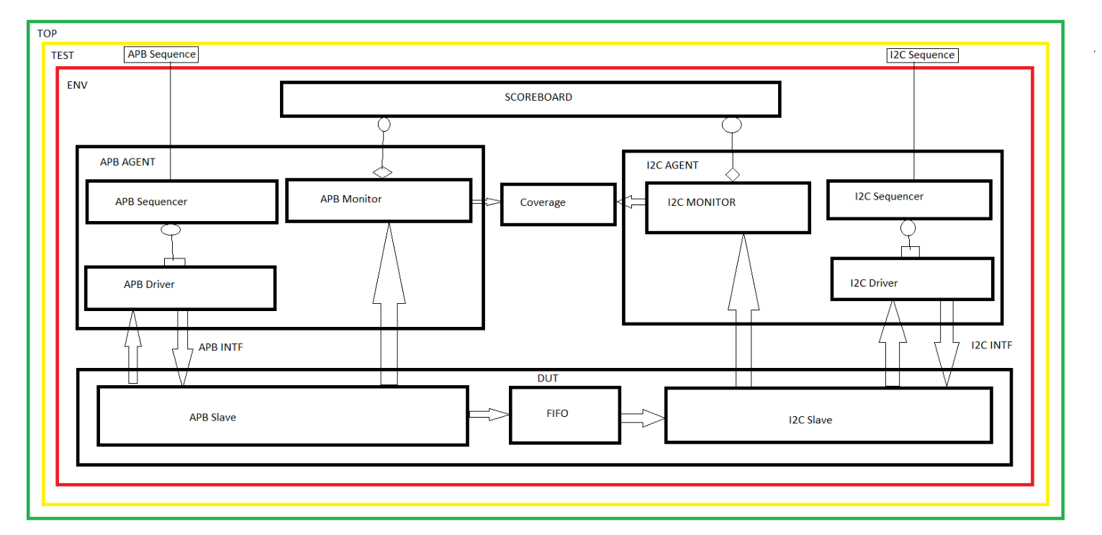
TB Architecture

Slide 5
Architecture progress
Component | Progress | Status
DUT | 100% | Completed
APB Agent | 100% | Completed
I2C Agent | 100% | Completed
Scoreboard | 100% | Completed
Virtual sequence | 100% | Completed
Virtual Sequencer | 100% | Completed
Environment | 100% | Completed
Test | 100% | Completed
Top | 100% | Completed
Functional Coverage | 100% | Completed
Assertion | 0% | Ongoing

Slide 6
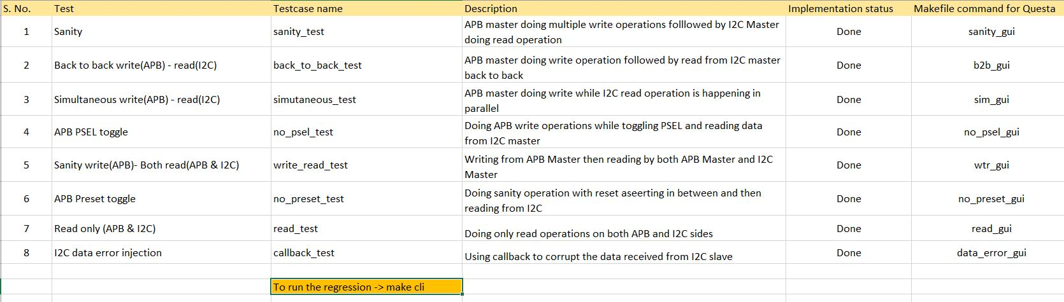
Testcases planned

Slide 7
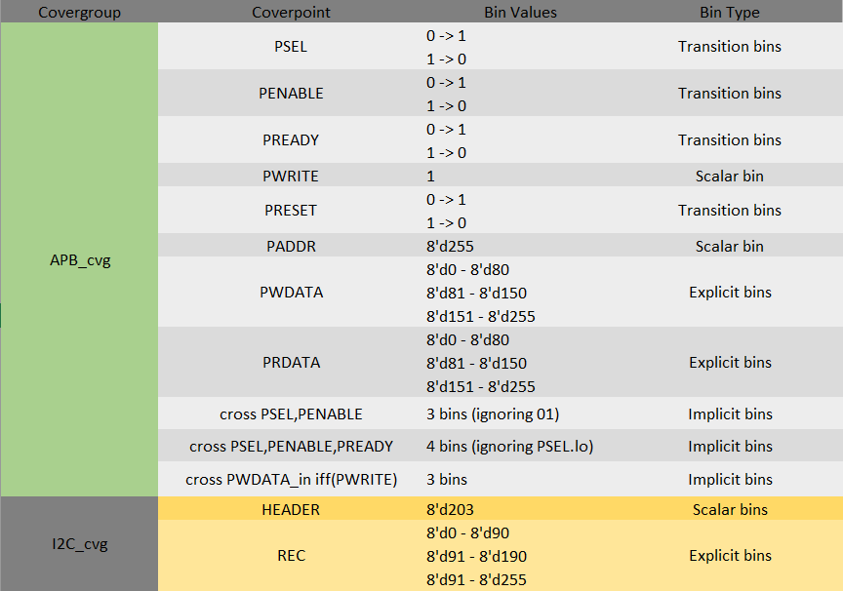
Coverage plan

Slide 8
Work remaining
Implementing assertions
Code optimizations
Adding comments

